Slide 1
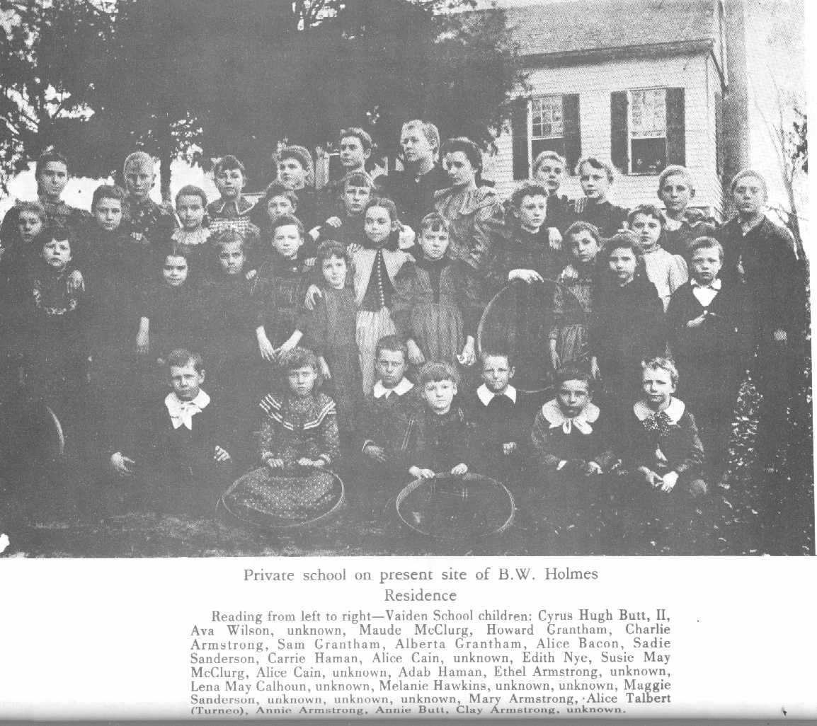
Does Systematic Exposure to Monty Python’s Flying Circus Cause Children to Acquire Vocabulary More Rapidly
John Q. Scholar
Center for Basic Research
Harvard University
April, 2009
Notes:
Four P’s:
Prepare your presentation.
Practice your presentation.
Present, and be positive.
Take a pee.

Slide 2
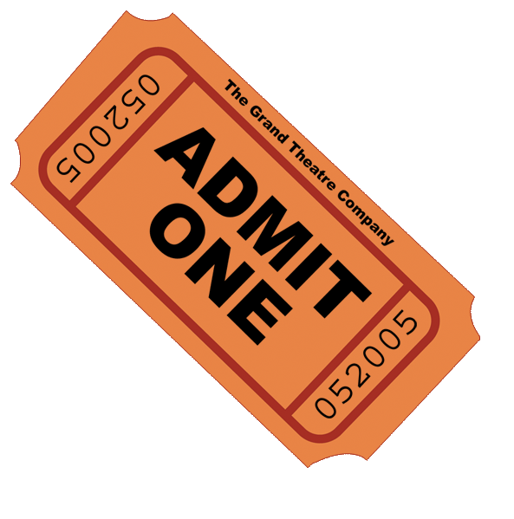
What Are My Research Questions?
Does watching Monty Python’s Flying Circus cause first graders to acquire academic vocabulary more rapidly than children who do not?
Cleese, et al. (1964).
Milligan & Sellers (1959).
Snow & Chall (1987)
Is the impact of the Monty Python’s Flying Circus treatment On Children’s Vocabulary Learning Greater for Children Who Are Expatriate English?
Secombe & Milligan (1976).

Slide 3
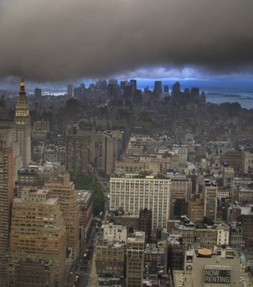
Where Did I Conduct My Study?
Conducted in the Amherst, Massachusetts, public schools ...
Additional case study and observational research on-going in the Belchertown State School.
Ancilliary details of the site and setting …

Slide 4
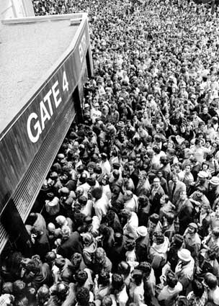
Whom Did I Include In My Sample?
248 families drawn randomly from a population of middle-class families with children about to enter first grade, who volunteered to participate in the study.
Summary demographic stats on families?
Each family provided one target child, all of whom then entered one of six Amherst public elementary schools, as first graders:
Total of 248 children.
Summary demographic stats on children?
Statistical power analysis indicates that, with this sample size, I had moderate power (.80) to detect a small effect size (.10 st. dev.) at usual levels of Type I error.

Slide 5
What Procedures Did I Employ?
Randomized Experiment:
Children listed in random order and assigned alternately to Treatment (n=124) and Control (n=124) conditions:
Treatment families supplied with a DVD containing 120 Episodes of Monty Python’s Flying Circus.
Target child watched one episode per day, after school, on weekdays, for three months (Sept thru Nov).
Order of episodes was randomized within child (order of episodes on each family’s DVD was determined randomly).
Control families received no DVD.
Intent-to-Treat study, treatment fidelity not monitored.
Academic Vocabulary Monitored Over Time:
Seven equally-spaced biweekly waves of data.
Standardized Prognosis of Language Under Duress (SPLUD) – Academic Vocabulary subtest.
Administered biweekly at school, Sept thru Nov.

Slide 6
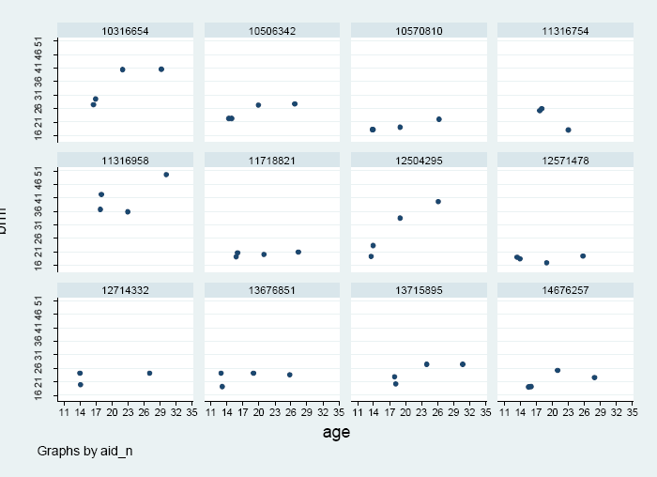
What Are My Measures?
Outcome Variable:
VOCAB: Score on the academic vocabulary subtest of the SPLUD score (0-100), nationally-normed and vertically equatable.
Question Predictors:
T: Time (in months).
TREAT: Dichotomous variable indicating the child’s experimental condition (1=Treatment; 0=Control).
EXPAT: Was the target child expatriate English (1=yes; 0=no)?
Covariate:
S: Vector of six dummy variables representing each of the Amherst public elementary schools (Fort River School omitted as reference category).
Treatment
Control
Vocabulary at Baseline
Control
Mean = 24.19
Treatment
Mean = 25.12
Scaled SPLUD Score

Slide 7
What Data-Analyses Did I Conduct?
Individual growth modeling (IGM), with the Multi-Level Model for Change (MMC):
RQ #1: Does watching Monty Python’s Flying Circus cause first graders to acquire academic vocabulary more rapidly than children who do not?
Level-1 individual vocabulary learning trajectory (assumed linear):
Level-2 model for inter-individual differences in vocabulary learning:
Usual assumptions on the residuals.
Causal Impact of Treatment on
Rate of Change in Vocabulary
RQ #2: Is the impact of the Monty Python’s Flying Circus Treatment On Children’s Vocabulary Learning Greater for Children Who Are Expatriate English?
Level-2 model replaced by:
Differences in Causal Impact of Treatment on
Rate of Change in Vocabulary, by expatriate status
Vocabulary Learning & Monty Python Slide #7
John Q. Scholar, Center for Basic Research, 2009

Slide 8
RQ #1: Monty Python Means Greater More Rapid Vocabulary Learning!
Parameters | Model A: Unconditional Growth Model | Model B:
Fixed Effects
Initial Status:
Intercept, γ₀₀ | 20.5*** | 2.4***
Rate of Change:
Intercept, γ₁₀ | 4.2** | 2.2*
TREAT, γ₁₁ |  | 6.8**
Variance Components
Level-1:
Residual, σ_{ε}² | 10.7** | 10.7**
Level-2:
Initial Status, σ₀² | 5.45*** | 5.42***
Rate of Change, σ₁² | 3.09** | 1.33*
-2LL | 2784.2 | 2655.3
Interpretation, as usual … watching Monty Python causes children’s vocabulary score to increase by almost 7 points more per month … etc.
Interpretive Visual
*p<.05 ** p<.01 *** p<.001
Parameter estimates for covariates not included to save space.

Slide 9
RQ #2: Monty Python Matters More for Children of the Expat English!
Parameters | Model A: Unconditional Growth Model | Model B:
Fixed Effects
Initial Status:
Intercept, γ₀₀ | 20.5*** | 2.4***
Rate of Change:
Intercept, γ₁₀ | 4.2** | 2.2*
TREAT, γ₁₁ |  | 4.2**
EXPAT, γ₁₂ |  | 0.2**
EXPAT×TREAT, γ₁₃ |  | 3.9**
Variance Components
Level-1:
Residual, σ_{ε}² | 10.7** | 10.7**
Level-2:
Initial Status, σ₀² | 5.45*** | 5.42***
Rate of Change, σ₁² | 3.09** | 1.33*
-2LL | 2784.2 | 2655.3
Interpretation, as usual … the effect of Monty Python on Expat Children’s vocabulary learning is …
…. blah blab.
Interpretive Visual
*p<.05 ** p<.01 *** p<.001
Parameter estimates for covariates not included to save space.

Slide 10
Threats to Validity?
Internal Validity:
Attrition from the study was minimal.
Did not ask whether control families purchased their own copies of the Complete Monty Python, or borrowed copies from treated families.
Can generalize only to a population of volunteer middle-class families, with children entering first-grade.
External Validity.
Can generalize only to a population of volunteer middle-class families, with children entering first-grade.
Can generalize only to a population of volunteer middle-class families, with children entering first-grade.

Slide 11
What Is the Big Picture?
Monty Python Makes A Difference for All Children. On average, children will acquire academic vocabulary more rapidly, if exposed to Monty Python’s Flying Circus (p<.001). We estimate that, after one year of exposure, children’s academic vocabulary will be almost half a standard deviation larger.
Monty Python Effect is Doubly Effective for Children of Expatriates. On average, children of expatriates will enjoy an even greater benefit (p<.01), increasing their vocabulary by almost one standard deviation over their non-expatriate untreated peers during First Grade.
We suggest immediate implementation nation-wide.

Slide 12
Where Do We Go From Here?
Our current findings capture only the causal impact of an “offer” of the Monty Python treatment on children’s learning of academic vocabulary.
Additional research is needed in order to obtain unbiased estimates of the “take-up” of the treatment.
We must confirm, as suggested by our extensive observational research in the Belchertown State School, that there are similar Monty Python effects on children’s learning of science, mathematics and potty-training.
Exploratory case study research suggests that there may be a “gender gap” -- Monty Python effects may be vastly reduced for girls.
Scientists in Germany hypothesize that this may be due to genetic differences in the structure of the female brain that prevent them from appreciating the humor in Monty Python.
More research is needed into whether Monty Python effects persist through into high-school, and college, and beyond into the labor-force.
Social Capital Theory suggests that treated children may have greater lifetime earnings, and eventually make bigger contributions to society and civilization.
Make sure not to miss the finale of “The Bachelor: On the Wings of Love.”
…

Slide 13
Pay due homage – other researchers may be in the audience and be prepared to offer your paper in a forthcoming special issue of the journal they edit!
Bibliography

Slide 14
Appendices:
Include an Appendix documenting the construction of your dataset, especially if you have used national data.
Provide ancillary descriptive statistics on the full sample and important subgroups.
Provide additional tables containing the results of fitting alternative model specifications, sensitivity analyses, etc.
Describe the approaches you used to deal with missing data, and other analytic problems.
Include ancillary slides that anticipate potential audience questions.
Etc. …

Slide 15
Overview of Main Points: The Four P’s …

Slide 16
Prepare Your Presentation …
Establish A Sensible Slide Format That Is Common Across All Slides:
Use footers and headers to maintain your title, authorship, affiliation, date.
Make sure each slide has an explicit title that explains what’s on that slide.
Don’t put too much on any one slide.
Provide An Attention-Grabbing Opening:
Slide #1: State title, author, affiliation, date, mention your personal interests.
Slide #2: State your research questions, discuss the literature and abiding issues.
Document The Background And Context Of Your Research:
Slide #3: Identify and describe your site.
Slide #4: Identify and describe your dataset.
Slide #5: Describe your sample, include selected descriptive statistics/plots, if possible.
Slide #6: Describe any important procedures used in the design or data collection.
Slide #7: Define your measures –outcome, question predictors, instruments, covariates.
Slide #8: Overview your data-analyses, by question, identifying critical parameters.
Present Your Main Findings, By Research Question:
Slide #9a: Prepare decent, sparse, well-annotated summary tables, by RQ.
Slide #9b: Create interpretive visuals to accompany answer to each RQ, if possible.
Provide A Memorable Closing:
Slide #10: Provide a “big picture” summary in words, directly addressing the RQs.
Slide #11: Comment on the “real-life” benefits or consequences of your work.
Slide #12: Outline the implications of your work for the future.
Prepare Appendices and Supplementary Slides (optional)
Prepare A Handout For Your Audience, Including a Bibliography (optional, but a good idea).

Slide 17
Practice Your Presentation …
Review Your Visuals Carefully:
Examine their clarity, clutter and relevance.
Decide, in advance, which slide(s) you’ll skip, if time runs out.
Identify some additional slides you’ll comment on if time allows.
Prepare To Present:
Plan every word you intend to say.
Write your script out in a large font, formatted to emulate spoken phrasing.
Use cautious animation to stage the presentation of each slide.
Avoid unnecessary animation (just like me?).
Rehearse Your Talk:
Videotape a practice run and review your performance with remote control & coach.
Obtain feedback from your coach on:
The strength of your opening & closing.
Your logical flow.
The credibility and clarity of evidence presentation.
The clarity and comprehensibility of your key points.
Your many distracting verbal mannerisms and physical ticks.
Check the physical environment in which you’ll present, in advance:
Check that you have everything you need (including a pointer).
Check the audience sightlines in advance, moving or removing seats as needed.
Fix your computer so that it doesn’t go to sleep while you’re being introduced.
Make sure that the projected image can be read from the back of the room.
Establish a reasonable surface to place (hide) your notes in plain sight.

Slide 18
Be Positive When You Present …
Be Positive About Your Talk:
Project a sense that you really value your material.
Do NOT read a script, but give your talk using your slides as “prompts.”
Be Positive About Yourself:
Be confident, yet relaxed.
Don’t be afraid to acknowledge a mistake, but don’t grovel.
Build Rapport With Your Audience:
Be yourself, be sincere.
Establish and maintain eye-contact with your audience.
Connect your message to what you think their experiences are.
Don’t adopt a “defensive” position -- move out towards, and into, the audience if that is possible.
If you don’t want questions until the end, say so!
If you don’t know the answer, don’t bluster – say “I don’t know the answer to that right not, but I will certainly look into it!”
Hold the Audience’s Attention:
Don’t stand rigidly, gripping the podium with white knuckles.
Have good decisive body animation.
Don’t be afraid to direct audience questions back to other audience members (or to the rest of the panel!).

